Slide 1

Group Members: Vipanshu Kumar Suman(0808IO221044) Divyam Pathak(0808IO221015)
IPS Academy, Indore
Institute of Engineering and Science
Department of Computer Science (Internet Of Things)
Guided By:
Miss. Nisha Bhalse

Slide 2

IMDB Movie Review Sentiment Analysis Using Machine Learning
+
+
+
Analyzing large dataset of movie reviews on IMDB to obtain positive and negative reviews
+
+
+

Slide 3

Introduction
With the rapid growth of user-generated content, especially in the form of online reviews, sentiment analysis has emerged as a critical tool to extract actionable insights from large volumes of text data. One such prominent platform is IMDB, where users post millions of movie reviews, reflecting their sentiments toward different films.
This project focuses on applying machine learning techniques to analyze the sentiment of movie reviews on IMDB. Sentiment analysis helps in determining whether a movie review expresses a positive or negative opinion. By training machine learning models on IMDB's vast dataset, we can automatically classify the sentiment of reviews with high accuracy.
Our approach uses natural language processing (NLP) techniques to preprocess the text data, followed by training models such as Naive Bayes, Support Vector Machines (SVM), or deep learning models. These models help in identifying patterns in how people express their sentiments in movie reviews.
The goal of this project is to create a model capable of analyzing movie reviews and providing valuable insights into public opinion, which can be useful for movie recommendations, marketing strategies, and understanding audience preferences.

Slide 4
Existing Solutions and Their Limitations:
Bag of Words (BoW) and TF-IDF: These traditional methods convert text into numerical features but often fail to capture context or word order, leading to limited understanding of complex sentences.
Naive Bayes Classifier: Simple and fast for text classification, but it assumes word independence, which oversimplifies language structure and context.
Support Vector Machines (SVM): Effective for binary classification, but it struggles with large datasets and is less efficient at capturing nuanced sentiment in long reviews.
Deep Learning Models (RNN, LSTM): These models capture sequential patterns in text but require large datasets and high computational power, making them harder to train and optimize.
Pretrained Transformers (BERT): State-of-the-art for text understanding but resource-intensive and prone to overfitting on small datasets without fine-tuning.

Slide 5
Functional Requirements:
Data Collection: The system must gather and preprocess movie reviews from the IMDB dataset, including tokenization and stop word removal.
Model Training: Train machine learning models to classify sentiment, using metrics like accuracy and F1 score for evaluation.
Sentiment Prediction: The system should predict the sentiment of new reviews in real-time, classifying them as positive or negative.
User Interface: A user-friendly web interface should allow users to input reviews and view the predicted sentiment instantly.
Performance: The system should ensure fast predictions (within 2-3 seconds) and be scalable to handle multiple users and large datasets efficiently.

Slide 6
Non Functional Requirements:
Performance: The system should provide sentiment predictions within 2-3 seconds per review to ensure a responsive user experience.
Scalability: It must efficiently handle increasing data volumes and user requests without performance degradation during peak usage.
Reliability: The system should maintain 99.9% uptime to guarantee continuous access to the sentiment analysis service.
Usability: The user interface must be intuitive, allowing users to easily input reviews and receive predictions without confusion.
Security: The system must protect user data and prevent unauthorized access, especially when processing personal reviews.
Maintainability: The architecture should be modular, allowing for easy updates and modifications as new machine learning techniques are developed.

Slide 7
Tools, Languages, or Frameworks:
Programming Language: Python is utilized for data processing, model training, and sentiment analysis due to its extensive libraries and community support.
Data Analysis Libraries: Pandas and NumPy are employed for efficient data manipulation and numerical operations, facilitating seamless dataset handling.
Natural Language Processing: NLTK and SpaCy are used for text preprocessing tasks like tokenization and stopword removal, enabling advanced NLP capabilities.
Machine Learning Frameworks: Scikit-Learn is used for traditional models like Naive Bayes and SVM, while Keras/TensorFlow support building and training deep learning models.
Web Framework: Flask or Django is chosen for developing the web application interface, providing a user-friendly platform for sentiment analysis.
Deployment: Gradio is employed to create a simple web interface that allows users to input reviews and see predictions in real-time.

Slide 8
Proposed Solution
Develop a sentiment analysis system using machine learning techniques to classify IMDB movie reviews as positive or negative.
Key Features:
High Accuracy Sentiment Classification
Efficient Text Data Processing
Scalable for Large Datasets
User-Friendly Web Interface
Real-Time Sentiment Predictions

Slide 9
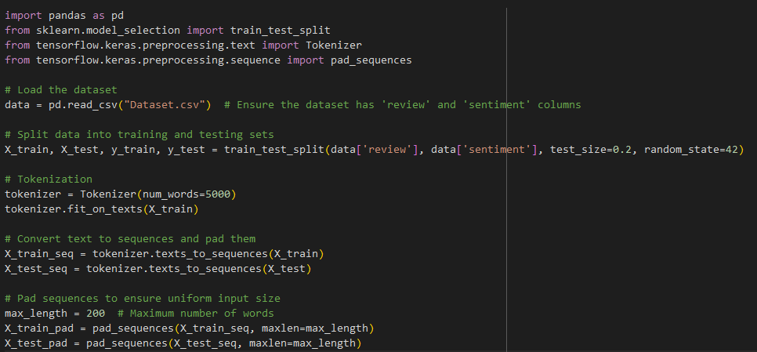
1. Data Preprocessing
Load the dataset and split it into training and testing sets.
Use a tokenizer to convert text reviews into numerical sequences.
Pad sequences to ensure uniform input size (200 words).
80% of data is used for training
20% of dats is used for testing

Slide 10
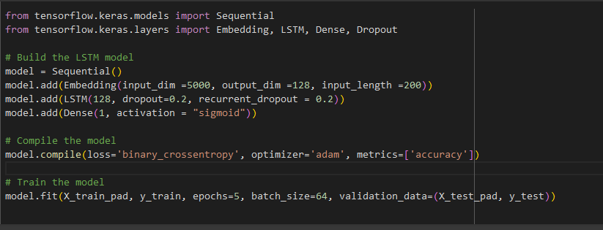
2. Model Training
Build a Sequential LSTM model with embedding, LSTM, and dropout layers for regularization.
Compile the model with binary crossentropy loss (negative average of the log of corrected predicted probabilities used for classification problems) and train it using the padded sequences.

Slide 11
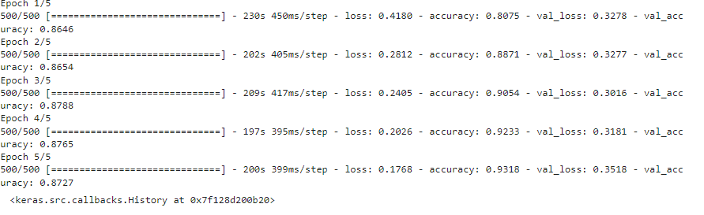
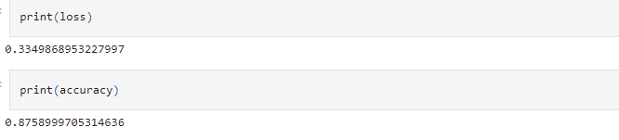

Slide 12
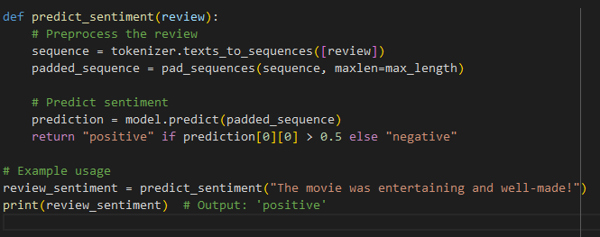
3. Sentiment Prediction
The predict_sentiment function processes a new review and predicts its sentiment.
Returns "positive" or "negative" based on the predicted probability.

Slide 13
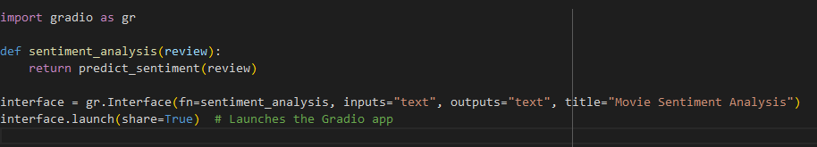
4. Web Interface with Gradio
Use Gradio to create a simple web interface that connects to the predict_sentiment function.
Launch the app, providing a shareable link for users to test the sentiment analysis in real time.

Slide 14

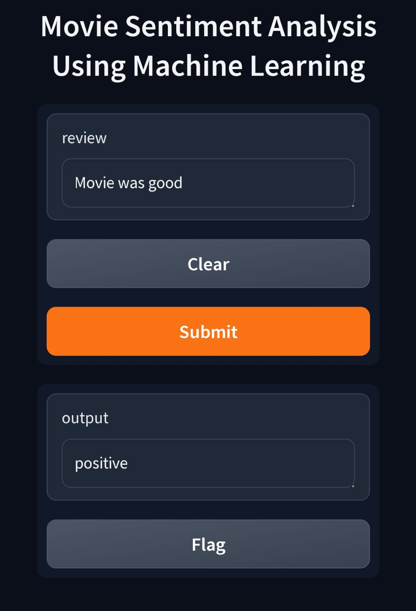
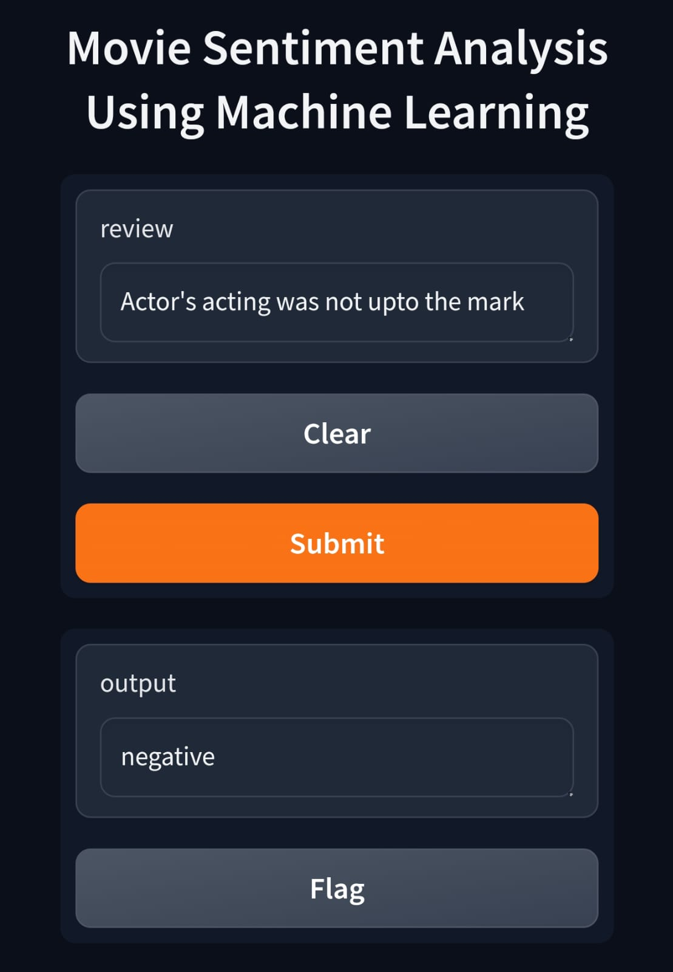

Output
Web Link
Code Link

Slide 15
System Architecture
Block Diagram:-
Movie Review Input → Text Preprocessing Module → Tokenization & Padding →
Sentiment Analysis Model → Sentiment Prediction Output (Positive/Negative)
Description of Components:
Movie Review Input: The raw text input from the user (e.g., a movie review).
Text Preprocessing Module: This module cleans and prepares the text for analysis (e.g., removing stopwords, punctuation).
Tokenization & Padding: Converts the preprocessed text into numerical sequences and ensures uniform length for model input.
Sentiment Analysis Model: The trained machine learning model (e.g., LSTM) that processes the input data to classify sentiment.
Sentiment Prediction Output: The final output indicating whether the sentiment is positive or negative.

Slide 16

Thank You!

